Slide 1

Women’s faces sorted by age from 19 to 70 years old
GROUP 4 PRESENTATION

Slide 2
Summary of findings
Source, format, & shape
Purpose of dataset
Assumptions
Related debates

Slide 3
1. Source, format, shape
Source: Russian dating site tabor.ru (about 35 million registered users)
Format: multiple images (JPG) for each age ranging from 19 to 70
Shape: 56890 images in total

Slide 4
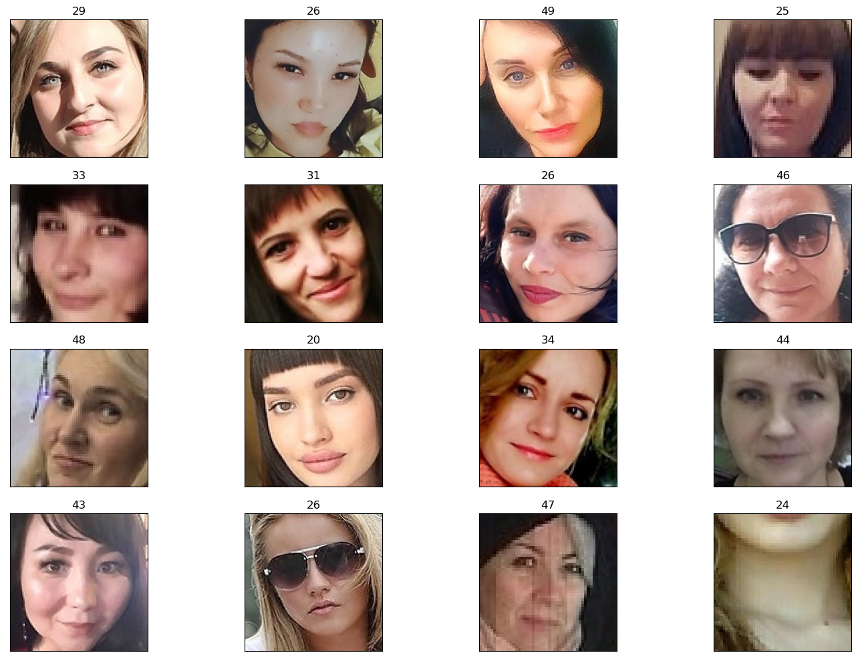
2. Purpose of the dataset
Record differences and make connections between facial features and age
Sort women’s faces by age (MIN age: 19, MAX age: 70)

Slide 5
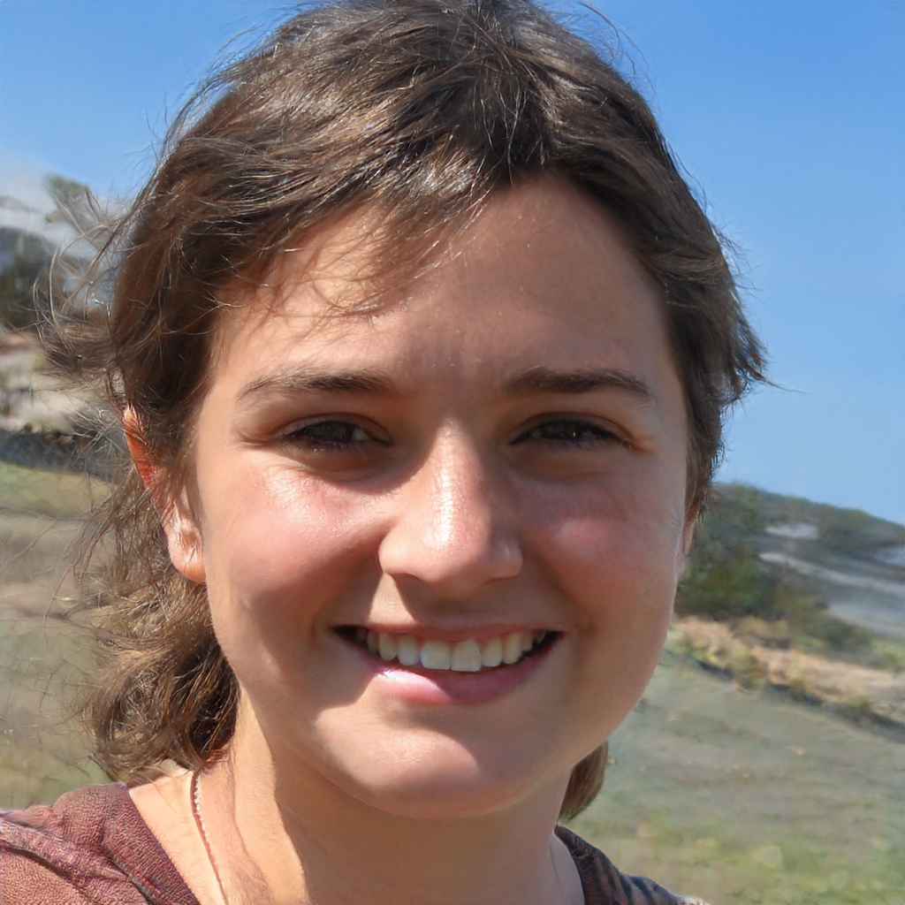
3. Assumptions
Are there underaged women pretending to be > 18 years old to get on the site?
Are there women who claim themselves younger/older on the dating site for any reason?
Are there any fake profile pictures? (Figure 1)
There are multiple images with filters on => Would this affect the model’s accuracy?
Figure 1: Fake profile picture from thispersondoesnotexist.com

Slide 6
3. Predictive Power
Reusability and predictive power of any model using this dataset:
- Majority of sampled women are light-skinned looking (mostly Caucasian and northern Asian women), which is understandable considering the country where the sample is pooled from is Russia.
- How does this affect the model? Let’s look at some PULSE and StyleGANS examples (Figure 2)

Slide 7
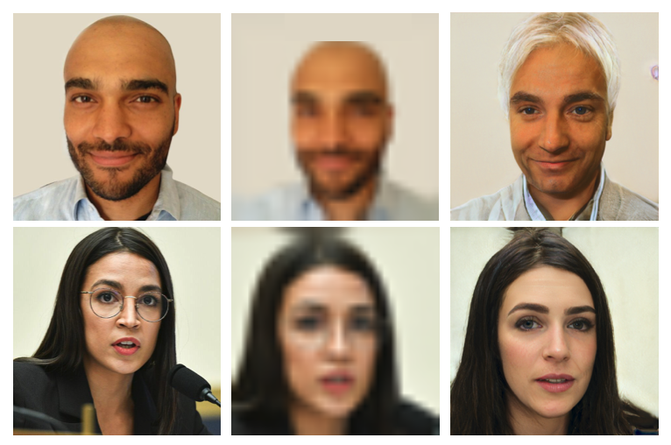
3. Predictive Power (cont.)
What is PULSE?
An open-sourced application that reconstructs high-resolution human faces from their pixelated images.
What is StyleGANS?
A generative ML model developed by NVIDIA researchers to create realistic human faces (like the one on Figure 1)
Figure 2:PULSE algorithm (p.1)
Original input -> Pixelated input -> PULSE’s output

Slide 8


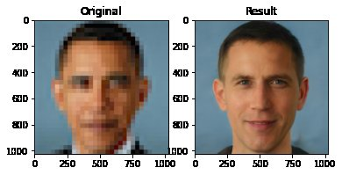
3. Predictive Power (cont.)
Figure 3: PULSE algorithm (p.2)
Figure 4: PULSE algorithm (p.3)
Figure 5: PULSE algorithm (p.4)

Slide 9
3. Predictive Power (cont.)
Why does that happen?
1. StyleGANs arguably train their models on mostly light-skinned/Caucasian faces -> Racial BIAS
2. PULSE

Slide 10
3. Predictive Power (continued)
Imbalanced dataset:
More than 1000 files for Women of 19-48 years old
Less than 300 files for Women of 60-70 years old
=> Majority of women in the dataset are 19-45 years old => will create ageist bias in model

Slide 11
3. Predictive Power (continued)
Reusability and predictive power of any model using this dataset: majority of sampled women are light-skinned and Caucasian looking.
True accuracy of the model in the presence of filters. (make them younger, cuter, ?)
Imbalanced dataset:
>1000 files for Women of 19-48 years old
<300 files for Women of 60-70 years old
Majority of women in the dataset are 19-45 years old => will create bias in model

Slide 12
4. How to improve bias in AI
More diverse AI research teams
Data Collection

